Slide 1
A Modernized Developer's Workflow with Domino/XPages
Eric McCormick

Slide 2
Audience
Notes:
developers
familiar with XPages
already familiar with:
CSS frameworks e.g.- Bootstrap / Foundation
JS libraries e.g.- jQuery / Dojo (core)
basic understanding of implementation of front-end MV* frameworks (you’ve played with them at a minimum)
the will to learn a couple things, to automate development concerns

Slide 3


Who Am I?
developer
husband
father
veteran
former EMT
blogger
…more than I have space for
Eric McCormick .io
@edm00se
blog: edm00se.io

Slide 4

Who Am I?
Web Developer at
a fourth-generation, family-owned professional construction services firm, in operation since 1889
my focus usually revolves around:
document control
productivity and performance metrics
system integration
process automation

Slide 5
Agenda
What and Why
How? (in the App)
Split front-end and back-end (RESTful APIs)
HttpServlet
OSGi plugin (JAX-RS)
XPage w/ xe:customRestService (Java or SSJS)
XAgent
Back-end primary logic
Front-end heavy app
Observations of a corporate developer
How? (Outside the App)
Demos
Notes:
alternative to RESTful API could be data transfer/API via:
web sockets
XML-RPC / SOAP (less compact, will require a library to transform to/from JS)
passing well formated CSVs (please don’t!)

Slide 6
What and Why?
Modern web apps
using all the fancy new toys
existing Domino server
XPages runtime
all the Java server stack power
XPages components
user / security model
performance optimizations
lots of development tooling
eases concerns of:
testing
documentation
deployment
eases sanity
Notes:
don’t just “use the fancy new toys”, do so because:
they make sense
they’re marketable for you (your skill set)
they’re easier to pull in non-specific external help (e.g.- a contract Angular dev costs $$, while a contract Domino + XPages + … dev costs $$$)
there’s a lot to be said for sanity

Slide 7
App Concerns: Splitting the App Logic
where does the application logic lie?
business logic
workflow logic
server-side logic:
primary logic
enforceable rules
notifications
(additional) server events
client-side logic:
how the “form” operates
specifics to UI/UX, or the device (e.g.- camera, barcode scanner)
Notes:
use case, RFIs:
business logic: has requirements:
Request required fields [reqDate,subject,from,to,details]
actions on send/receive (notifications, approval)
Reply required fields [repDate,details]
actions on send/receive (notifications, approval)
workflow logic:
status of process (New/Draft, Request Pending/Review, Request Posted, Reply Pending/Review, Reply Posted)
solution: progress bar with “steps” (the possible states aren’t secret, don’t keep them that way! the higher order business requirements are intact, in the server logic)
no further questions to help desk regarding “where is this RFI at?”

Slide 8
App Concerns: Back-End
“best way” of establishing RESTful (or other) APIs:
OSGi plugin driven
NSF driven
HTTPServlets (rather, extending DesignerFacesServlet)
xe:restService
xe:customServiceBean
other (even Domino’s SSJS)
XAgent
adding tooling:
OSGi plugins mean we can use “real” Eclipse for development
can use things like JAX-RS (which the rest of the JEE world uses!)
for those willing/abel to make an edit to the Domino servers java.pol(icy) file:
GSON
otherwise the com.ibm.commons.util.io.json way
Notes:
*note: the “best way” will depend on the developer’s skill level and knowledge (as with all things)
for more, check out:
Jesse Gallagher’s blog series on OSGi plugins
Toby Samples’s blog posts on JAX-RS w/ Domino/XPages
my StackOverflow answer on the varieties of RESTful API creation in Domino/XPages

Slide 9

App Concerns: Front-End Concepts
you can use all the fancy toys
you “deploy” your built app to your ODP’s WebContent/ path
properly structured, you can use back-end mocks for DDE-less preview and edits
some tooling (angular-cli, webpack, etc.) automates this
Notes:
webpack is awesome
does lots of advanced optimization of assets
built in dev server
hot reloading
beats the pants off my previous json-server + browser-sync + gulp scripts (it all just does it!)

Slide 10
App Concerns: Front-End Implementation
use all the things!!1
build for deployment
profit
caveats:
know what you’re doing
don’t obliterate WebContent/WEB-INF/
Notes:
knowing what you’re doing is made easier, if you learn from all the other people in the field (e.g.- lots of webpack info, tutorials, etc.)
keep in mind our deployment scenario (Domino)
obliterating WebContent/WEB-INF is harder if we’re using source control
it can be accounted for, example from a node based tooling project (an Angular2 app)...

Slide 11
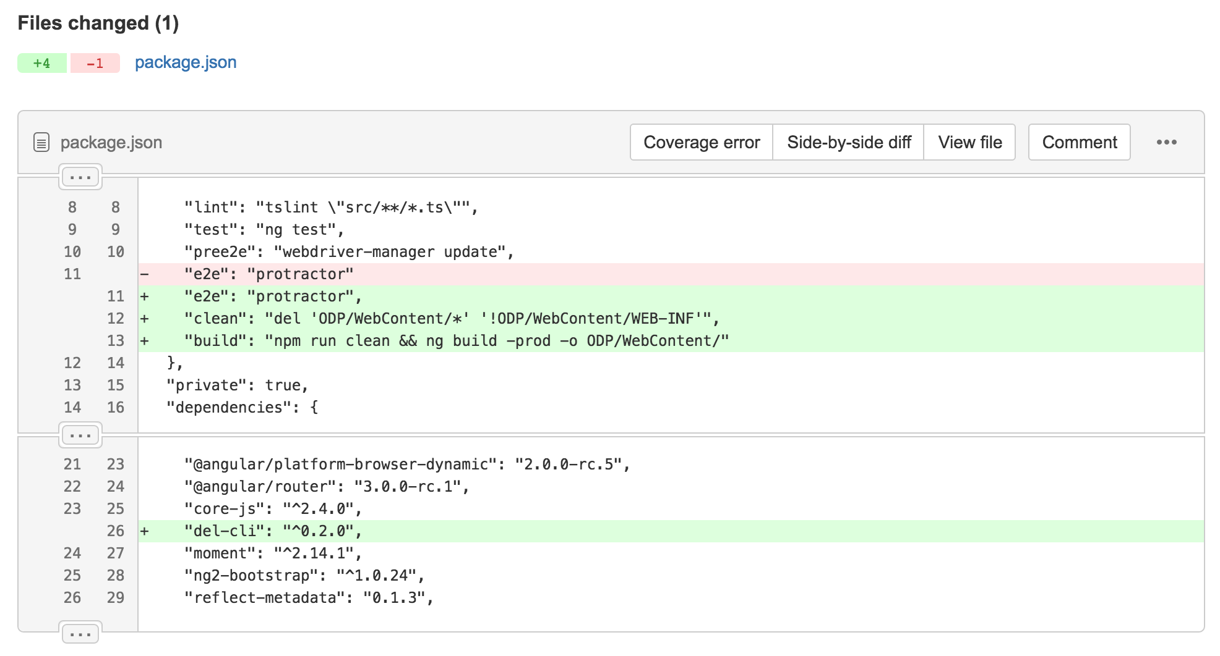
App Concerns: Front-End Deployment
Notes:
npm scripts for build pipelines are increasingly popular
lots of fancy front-end frameworks require dependencies via npm anyway
you can still use a task runner, but surfacing tasks in a single, consistent manner is always good

Slide 12
Observations of This Corporate Developer
scm for everything
if you spend on a task, automate it
to the extent available
build scripts should be:
minimal effort (one-line commands are easy)
configured as non-invasively as possible
“anyone” should be able to pull the latest:
code
build
submit a feature branch / PR
CI / CD considerations:
headless DDE builds
more?
Notes:
git repo should be as unified for the project as possible
unless the need to split apart for commit driven builds is needed (git submodules can be your friend!)
configuring environments should be handled by environment variables as much as possible
commonly performed operations can always be improved
the more I deal with non-Domino development, the more I want what everything else has, such as:
Node app scaling and balancing in Docker containers
virtually precise environment duplication (dev vs prod, etc.)
automated builds by commit, PR, release

Slide 13
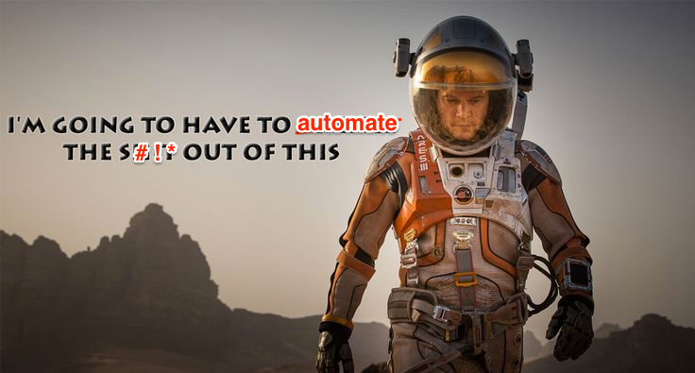
Why a “Developer’s Workflow?”
Automation is King
Focus on the task at hand
If the steps are reproducible, they should be automated/ scripted/etc.
You can waste your time configuring and setting up
Or you can get to work
Notes:
An Argument for Automation: https://medium.com/@kentcdodds/an-argument-for-automation-fce8394c14e2
focusing on the “task at hand” is a part of why I’m a fan of “configuration over code”
automated process (configured correctly), are far harder to screw up
channel your inner Mark Whatney

Slide 14
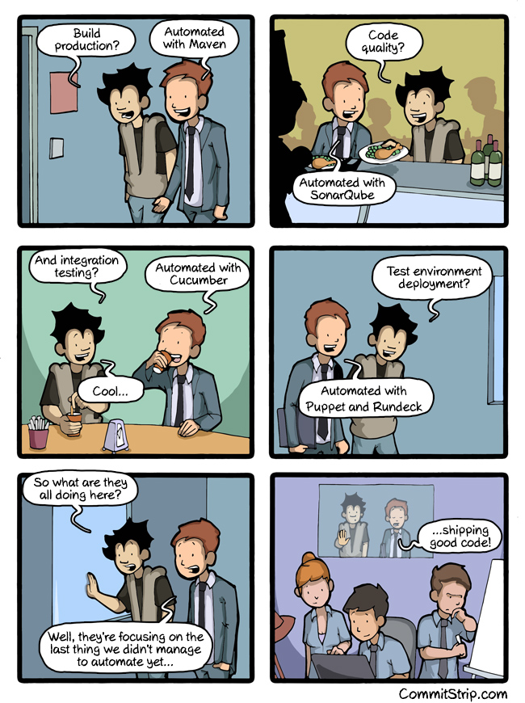
http://www.commitstrip.com/en/2015/06/22/can-we-automate-everything/
Notes:
in other words… our goal is: to focus on writing good quality code (and nothing else)

Slide 15
Beyond the App
GitLab has CI capabilities baked in
running GitLab in a docker container makes upgrades amazingly simple
installing the GitLab CI runner on Windows easy
much easier than the setup required for setting up Jenkins for headless DDE builds (a la Cameron Gregor)
can set PowerShell as the default shell environment
the runner is registered w/ the main GitLab env, can “tag” (e.g.- Windows, DDE, PS)
can limit # of simultaneous executions (aka- only one DDE build at a time)
the possibilities are endless
Notes:
endless possibilities include:
Domino in a docker container
docker - Domino server for dev/test purposes
programmatically invoked:
build
test
deploy
of an NSF!?!

Slide 16
Demos

Slide 17
Choose Your Own Adventure!
Back-End
Front-End
generator-xsp
HTTPServlets, xe:restService
generator-webapp
generator-angular
TypeScript setup (simplified, DIY)
angular-cli (Angular 2)
vue-cli (templates, w/ browserify or webpack)
Notes:
general progression:
project scaffolding:
framework
ODP
TypeScript
more complete picture

Slide 18
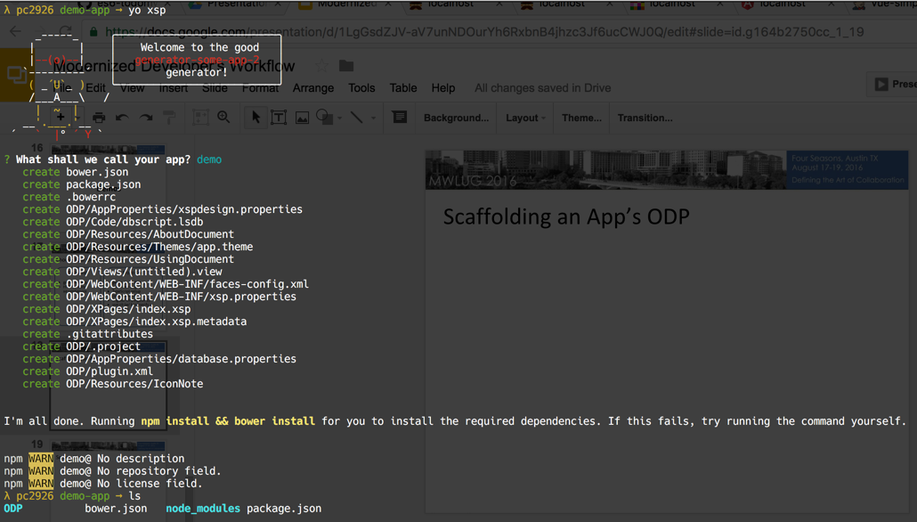
Scaffolding an App’s ODP (generator-xsp)

Slide 19
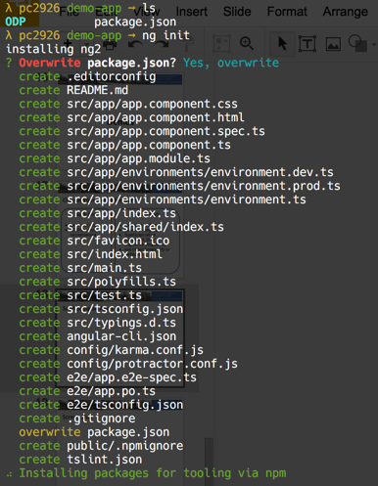
Scaffolding an App’s Front-End 1/2

Slide 20

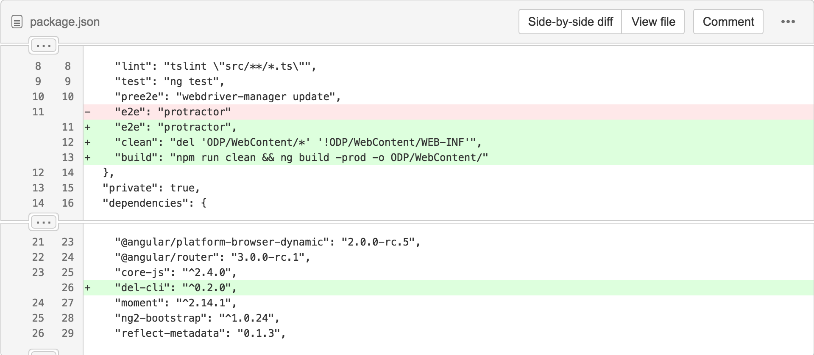
Scaffolding an App’s Front-End 2/2
change the dev/build scripts to:
output to ODP/WebContent/
not obliterate your ODP/WebContent/WEB-INF/

Slide 21
Q&A

Slide 22
Coming to my blog soon...
more on generator-xsp
extending beyond my task runner series
to include use of webpack w/ front-end apps on Domino/XPages

Slide 23
Thank You!

